Slide 1
(insert region) XYZ Chapter Meeting

Slide 2
Thank You Platinum & Sustaining National Supporters!

Slide 3
About CJE
National Non-profit Education & Resource Center for Job Order Contracting and related IDIQ Project Delivery methods.
Education Center – Unparalleled Learning Opportunities
Credentialing HQ for CJP (Certified JOC Professionals)
Resource Center – Connect & Consult – Owners' Advisory Council
Networking & Collaboration – 50/50 owner/contractor membership

Slide 5
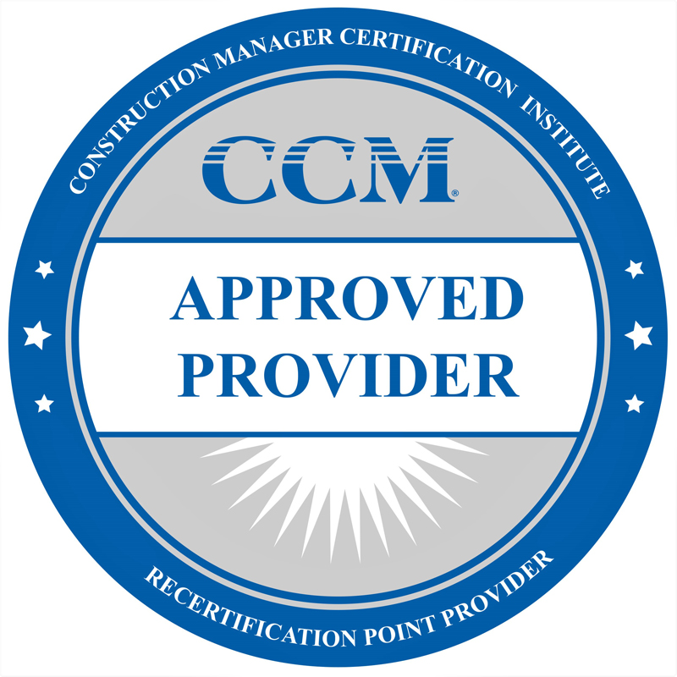

Slide 6
Today’s Topic or Presenter Info goes here

Slide 7
Speaker’s presentation insert here

Slide 8
Chapter Announcements
Upcoming Events:
Next Chapter Meeting – When & where
visit JOCexcellence.org to sign-up
Annual Scholarship event – what & where

Slide 9
THANK YOU!
Visit JOCexcellence.org to join today!

